Slide 1
CREDIT RISK MODEL PROJECT
GROUP 15
PROJECT BY:
Romit Jain
Rukmangada
Shreya Raghunath

Slide 2
Executive Summary
Goal:
Develop a Default Risk Model to enhance credit approval decisions by defining a strategic approach to credit card approvals, optimizing for both risk management and revenue growth.
Strategy:
Defined two targeted strategies—conservative and aggressive—each with distinct acceptance thresholds based on applicant default probability, allowing for flexibility in risk tolerance and revenue objectives.
Outcome:
Our proposed decisioning framework enables your business to mitigate risk effectively, improve decision-making precision, and secure a competitive edge in the market through a data-driven credit approval process.
 | Train |  |  | Test 1 |  | Test 2
 | Threshold | Default Rate | Revenue | Default Rate | Revenue | Default Rate | Revenue
Conservative Strategy | 0.3 | 2.02% | $8,069 | 4.84% | $1,728 | 4.84% | $1,728
Aggressive Strategy | 0.5 | 5.01% | $8,272 | 8.50% | $1,775 | 8.50% | $1,775

Slide 3
Dataset Information
Dataset includes historical data for each customer spanning up to 13 months
Target Variable : Whether the Customer Defaulted on Payments or Not
Original Train Data Size:
Rows: 5,531,451
Columns: 190
20% Sampled Data:
Rows: 1,107,082
Columns: 191
Unique Customers: 91,783
temp_yearmonth | default_observation | total_observations | default_rate_per_month
2017-03 | 18209 | 79285 | 0.2297
2017-04 | 18824 | 80471 | 0.2339
2017-05 | 18928 | 80174 | 0.2361
2017-06 | 19686 | 82129 | 0.2397
2017-07 | 20221 | 83211 | 0.243
2017-08 | 20722 | 84262 | 0.2459
2017-09 | 21125 | 85149 | 0.2481
2017-10 | 21538 | 86072 | 0.2502
2017-11 | 21898 | 86876 | 0.2521
2017-12 | 22302 | 87783 | 0.2541
2018-01 | 22740 | 89288 | 0.2547
2018-02 | 23158 | 90599 | 0.2556
2018-03 | 23543 | 91783 | 0.2565

Slide 4
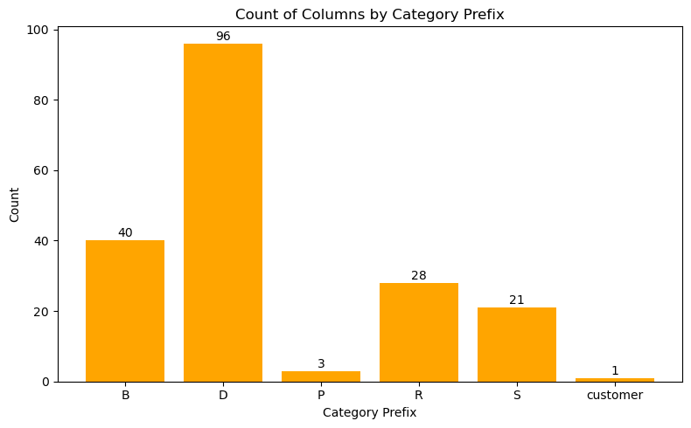
Features
Feature Group | Prefix | Example Variables | Description
Delinquencies | D_ | D_39, D_41 | Missed payments, late flags
Spending | S_ | S_11, S_24 | Monthly transaction activity
Balances | B_ | B_1, B_2 | Amount owed, balance trends
Payments | P_ | P_2, P_4 | How and when customers pay
Risk Flags | R_ | R_1, D_63 | Risk indicators or internal scores

Slide 5
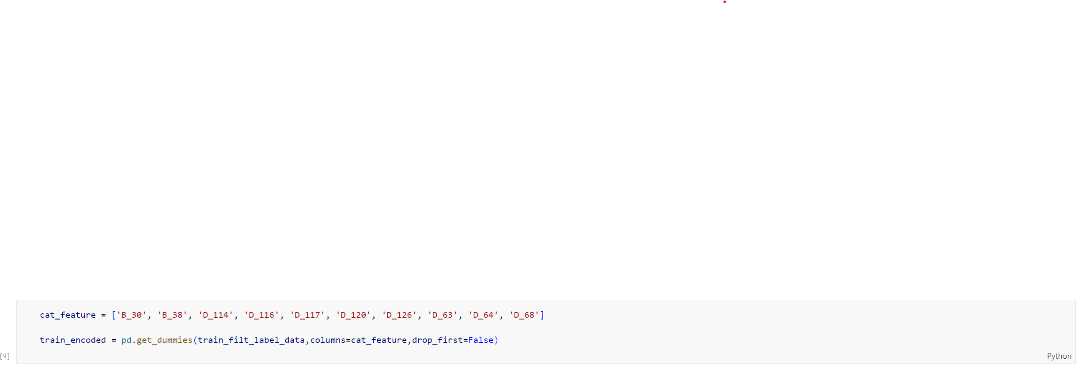
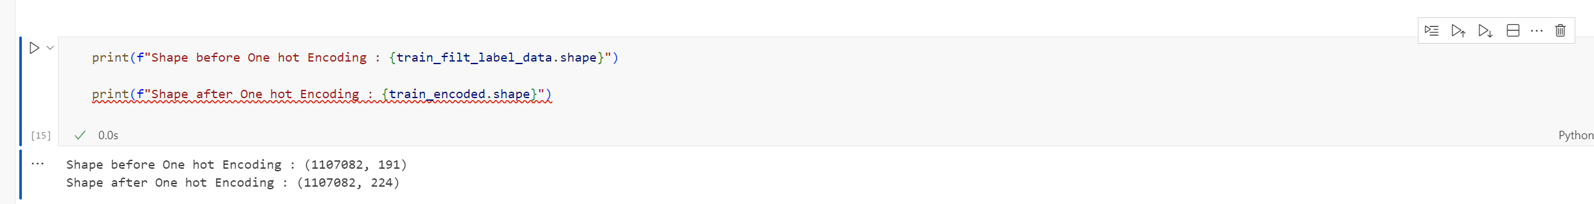
One hot encoding
Encoding Strategy
To convert categorical variables into a machine-readable format, we applied One-Hot Encoding. This creates binary (0/1) columns for each category within a feature.
We have included 10 categorical features as mentioned in the image.

Slide 6
Feature Engineering
Feature Engineering
Types of Engineered Features:
Numerical Features:
Average: Mean values calculated over specified periods (e.g., last 6 or 12 months).
Minimum: Lowest observed value over a defined timeframe.
Maximum: Highest observed value, indicating peaks in behaviour.
Sum: Total values aggregated over specified periods to capture overall activity.
Latest Value: Most recent observation to capture the current value of a feature.
Percentage Change: Year-over-year growth or decline metrics to assess trends.
Categorical Features:
Response Rate: Percentage of times a feature meets a specific condition (e.g., spending above a threshold).
Ever Response: Indicates whether a specific behavior occurred at least once in a given period.
Latest Value: Most recent observation to capture the current status of a feature.
Feature Category | No of Features
Delinquency | 1749
Balance | 734
Risk | 504
Spend | 378
Payment | 54
Feature | Mean |SHAP| | Count | Mean | Std | Min | 1% | 5% | 25% | Median | 75% | 99% | Max
P_2Ave3 | 0.739086 | 64248 | 0.633634 | 0.263685 | -0.36685 | -0.04551 | 0.14255 | 0.448151 | 0.677659 | 0.858786 | 1.004499 | 1.009965
P_2Min3 | 0.611443 | 64248 | 0.609315 | 0.273377 | -0.42058 | -0.10511 | 0.08695 | 0.421151 | 0.655024 | 0.840732 | 1.001447 | 1.009965
D_39Ave3 | 0.122494 | 64248 | 0.184167 | 0.276383 | 0.000007 | 0.001838 | 0.003268 | 0.00655 | 0.084197 | 0.268557 | 1.503917 | 4.449161
D_39Max3 | 0.168611 | 64248 | 0.334166 | 0.445368 | 0.000007 | 0.002849 | 0.005312 | 0.009275 | 0.206923 | 0.530282 | 2.295495 | 5.268649
D_39Max6 | 0.129803 | 64248 | 0.417674 | 0.463601 | 0.000007 | 0.005115 | 0.007495 | 0.033055 | 0.357742 | 0.621701 | 2.415726 | 5.268649

Slide 7
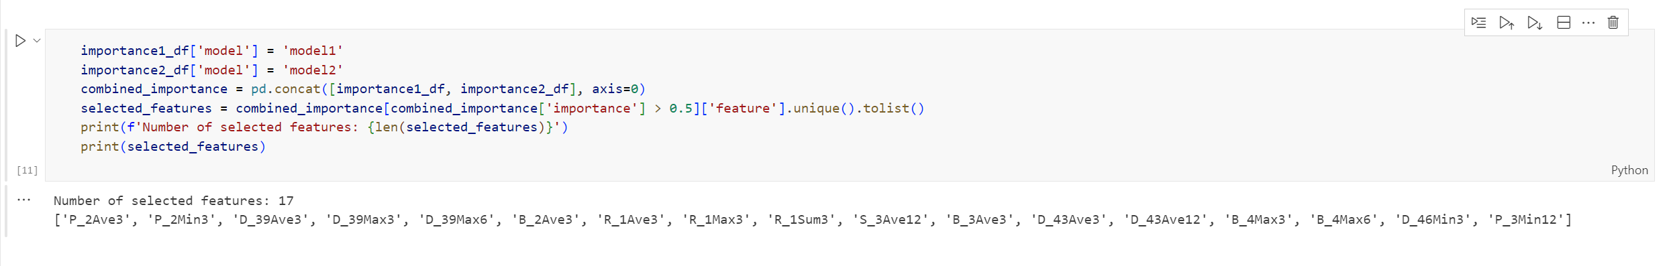
Feature Selection
How We Selected Features
To reduce dimensionality and improve model performance, we used a two-step feature importance approach with XGBoost models.
We trained two different XGBoost models:
Model 1: Default parameters
Model 2: Custom tuned with
300 trees
Learning rate: 0.5
Max depth: 4
Subsample: 50% of data
Colsample_bytree: 50% of features
Default class weight scaled 5x for defaults (to address imbalance)
We calculated feature importance from both models, based on how frequently and effectively each feature split the data.
For selection, we kept all features that had at least 0.5% importance in either model.
Outcome
Features selected for final model: 17

Slide 8
Grid Search
Parameter | Rationale | Values Tried
n_estimators | Controls number of trees; higher = more complexity | 50, 100, 300
learning_rate | Small values make learning more stable and avoid overfitting | 0.01, 0.1
subsample | Prevents overfitting by training each tree on a random subset of data | 0.5, 0.8
colsample_bytree | Trains each tree using a subset of features to reduce correlation | 0.5, 1.0
scale_pos_weight | Gives more importance to rare class (defaults) to address class imbalance | 1, 5, 10
Performed Grid Search to optimize XGBoost model.
Evaluated 72 model configurations.
Tuned:
Number of trees
Learning rate
Data & feature subsampling
Class imbalance handling
Goal: Improve performance by balancing bias vs. variance.

Slide 9
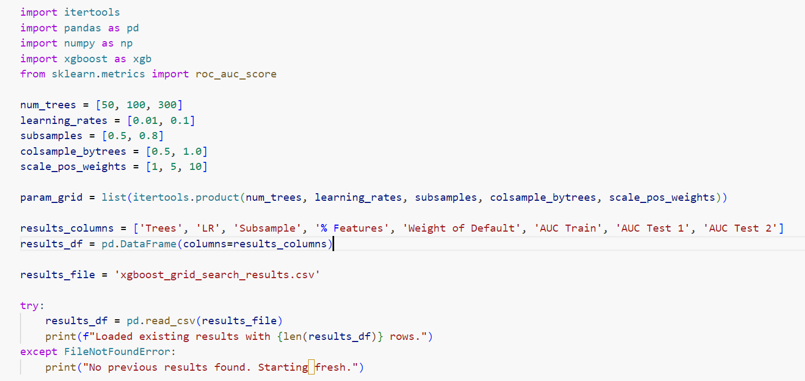
Grid search

Slide 10
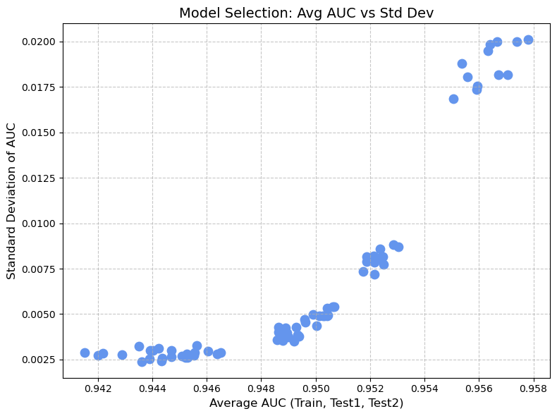
Grid Search (Model selection)
Chose model with highest AUC and low variance gap between train & test data.
Avoided overfitting: Some models excelled in training but dropped in Test2.
Balanced models were closer to the diagonal line, ensuring generalization.
Final model performed well on Test2 without overfitting.

Slide 11
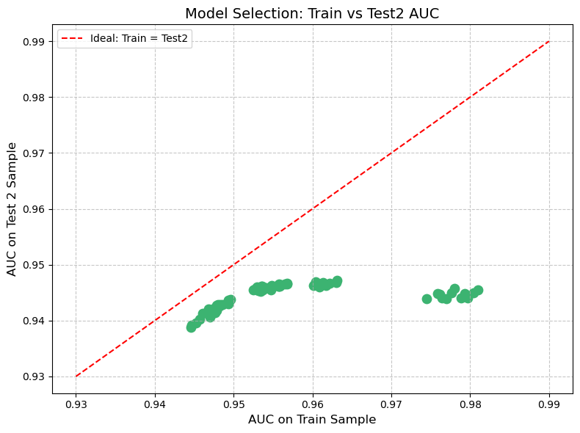
Grid Search (Model selection)
The first plot helped us find models that are accurate and stable.
The second plot helped us avoid models that overfit.
We chose a model that was high-performing, consistent, and generalizes well — the best all-around choice from the grid search.

Slide 12
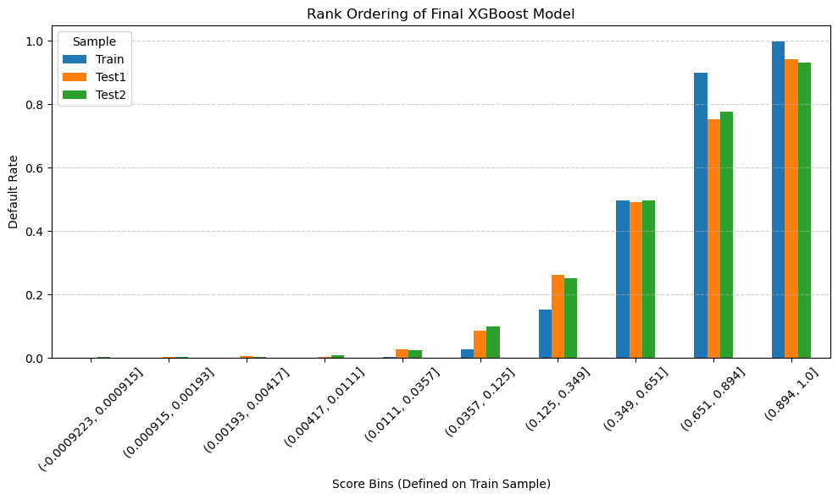
XGBoost Final model
Best Model Parameters: | Values
Model Number | 69
n_estimators | 300
learning_rate | 0.1
Subsample % | 80.00%
Features | 100.00%
% Weight of Default | 1
AUC Train | 0.980983
AUC Test 1 | 0.946963
AUC Test 2 | 0.945436

Slide 13
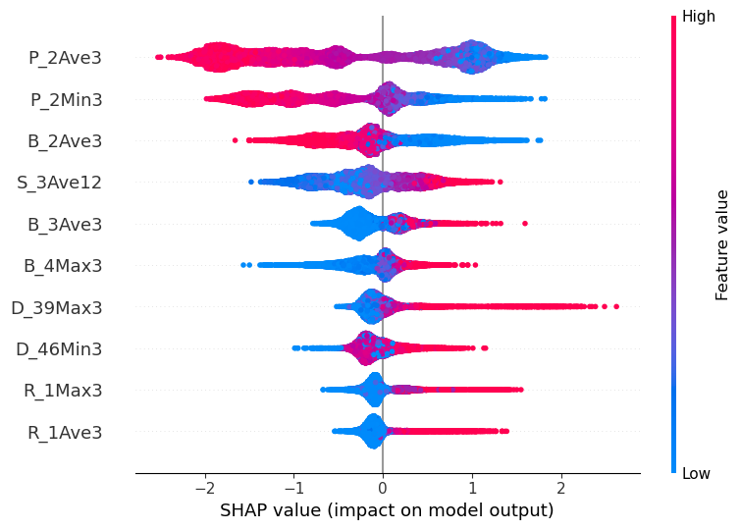
SHAP ANALYSIS - BEESWARM
P_2Ave3 (3-month avg. Payment Feature) → Most impactful 🟥 High → Higher risk | 🟦 Low → Lower risk
P_2Min3 → Similar to P_2Ave3, lower recent payments reduce risk
Balance Features (B_2Ave3, B_3Ave3, B_4Max3) → Can increase or decrease risk based on context
Stability (S_3Ave12) & Delinquency (D_39Max3) → Help distinguish stable vs. risky customers
Lower-ranked Features (R_1Max3, R_1Ave3) → Still relevant but with lesser impact

Slide 14
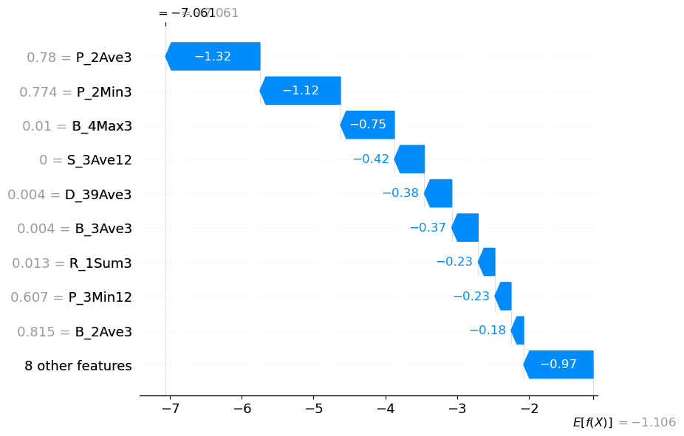
SHAP ANALYSIS – WATERFALL
P_2Ave3 & P_2Min3 → Lowered the score the most (–1.32, –1.12) → Low recent payments = Lower risk
Negative Contributors → B_4Max3, S_3Ave12, D_39Ave3 → Further reduced risk score
Interpretability → Model transparently shows feature influence
Business Impact → Can justify credit decisions & suggest improvements
Optimization TipIncreasing P_2Ave3 may further reduce risk, while R_1Sum3 & B_3Ave3 have smaller effects →

Slide 15
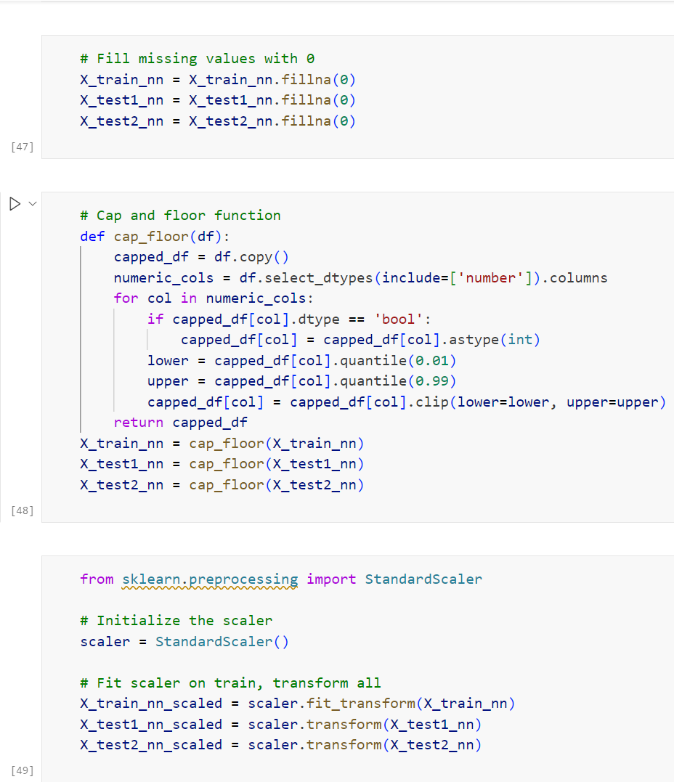
Neural Network – Data Processing
Feature Selection
We used the 17 most important features selected from the XGBoost model using SHAP values and feature importance.
These features were passed directly to the Neural Network model.
Neural Network receives data that is:
Clean (no missing values)
Normalized
Outlier-handled
Feature-selected
This results in more stable training, faster convergence, and better generalization.

Slide 16
Neural Network – Grid search
Approach → Manual Grid Search over various hyperparameters
Systematic Testing → Evaluated multiple configurations instead of guessing
Objective Selection → Identified the best architecture based on performance
Data-Driven Tuning → Ensured the final model was optimized with evidence
Hyperparameter | Values Tried | Why?
Hidden Layers | 2, 4 | Test depth and representational power of the neural network.
Nodes per Layer | 4, 6 | Control the model's capacity to learn complex patterns.
Activation Function | 'relu', 'tanh' | Compare performance and training stability with different activations.
Dropout Rate | 0.5, 0.0 | Reduce overfitting (50% dropout) or test without dropout (0%).
Batch Size | 100, 10,000 | Balance training speed and generalization with small and large batches.
Epochs | 20 | Limited by early stopping logic

Slide 17
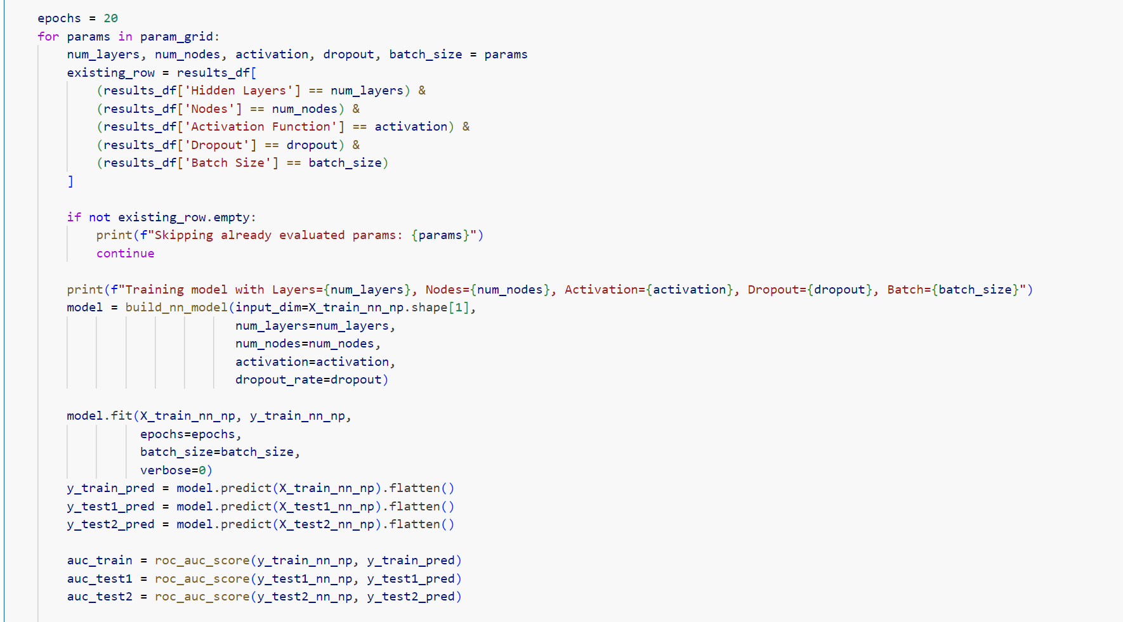
Neural Network – Grid search

Slide 18
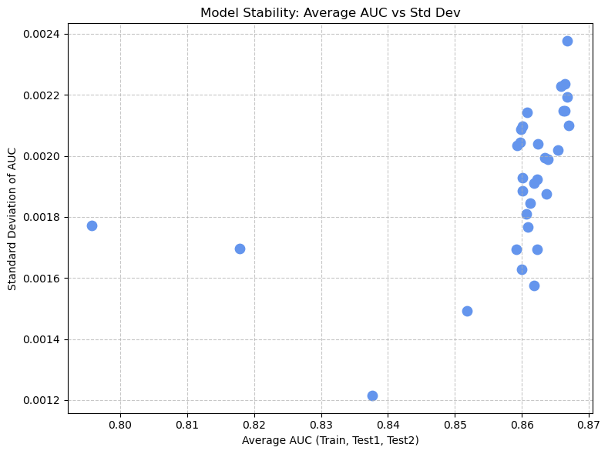
Neural Network
Plot 1: Average AUC vs Standard Deviation
Objective: Identify models that are both accurate and consistent
Plot Insight: Models with high AUC and low standard deviation are ideal
Model Selection: Chose the one at the bottom-right corner of Plot 1
Result: Ensures strong, stable performance across Train, Test1, and Test2

Slide 19
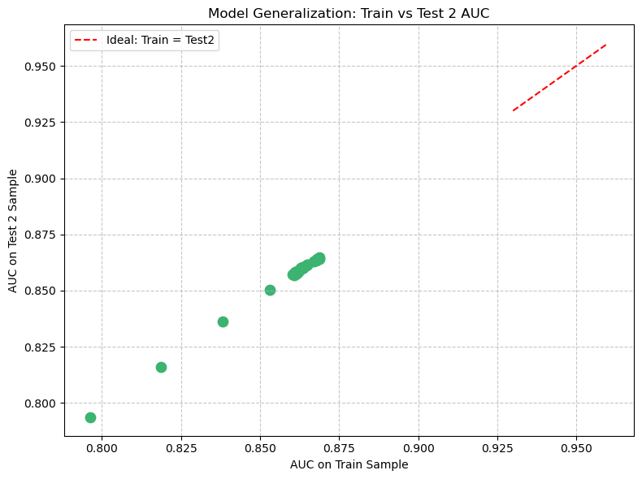
Neural Network
Plot 2: Train AUC vs Test 2 AUC
Purpose: Compare model performance between training and unseen (Test 2) data
Plot Insight: Models near the 45° red line show strong generalization
Model Selection: Picked the model closest to the diagonal
Result: High accuracy on unseen data with minimal overfitting

Slide 20
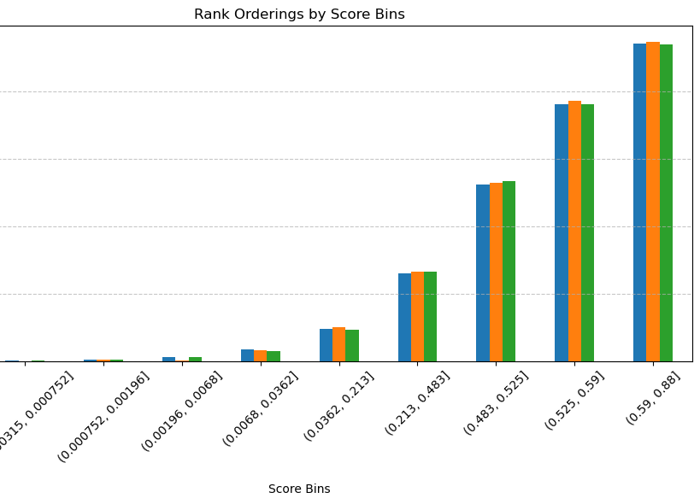
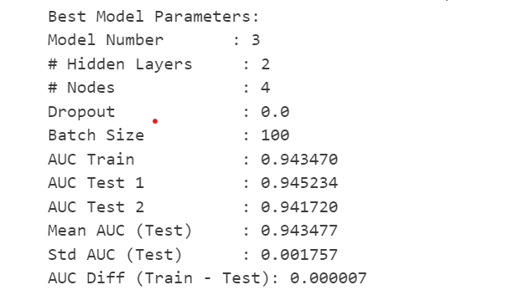
Neural Network – Final Model

Slide 21
Model Performance Comparison
Metric | XGBoost | Neural Network
AUC Train | 0.98098 | 0.94347
AUC Test 1 | 0.94696 | 0.94523
AUC Test 2 | 0.94544 | 0.94172
Avg Test AUC | 0.9462 | 0.94348
Train-Test2 Diff | 0.03554 | 0.00175
Final Model Selection: XGBoost
We compared both the XGBoost and Neural Network models using their final AUC scores on Train, Test 1, and Test 2. Based on performance, we selected XGBoost as the final model.
Why We Chose XGBoost
Higher AUC on all datasets, especially Test 2 (0.9454 vs. 0.9417)
More powerful model, able to learn complex patterns
Though Train-Test gap is higher, performance on unseen data is stronger
It consistently ranked customers by risk (validated in rank ordering)

Slide 22
Strategy
Revenue Calculation for Customer:
Monthly Revenue for 1 Customer = B_Ave × 0.02 + S_Ave × 0.001
Strategy Thresholds:
Conservative Strategy:
Threshold: 0.3
Default Rate: 2–5%
Focus: Strong risk cushion, minimal defaults, consistent revenue.
Balanced Strategy:
Threshold: 0.5
Default Rate: 8–9%
Focus: Maximizing revenue while managing default risk.
Threshold | Train Default Rate (%) | Train Revenue ($) | Test1 Default Rate (%) | Test1 Revenue ($) | Test2 Default Rate (%) | Test2 Revenue ($)
0.1 | 0.39 | 7450.53 | 1.8 | 1567.76 | 1.9 | 1595.9
0.2 | 1.09 | 7860.2 | 3.27 | 1645.24 | 3.28 | 1677.35
0.3 | 2.02 | 8068.59 | 4.83 | 1690.83 | 4.84 | 1727.71
0.4 | 3.29 | 8192.81 | 6.28 | 1719.97 | 6.7 | 1750.91
0.5 | 5.01 | 8272.02 | 8.14 | 1741.77 | 8.5 | 1774.52
0.6 | 7.12 | 8320.14 | 10.01 | 1757.13 | 10.36 | 1789.15
0.7 | 9.88 | 8346.93 | 12.54 | 1767.63 | 12.78 | 1799.48
0.8 | 13.43 | 8358.22 | 15.56 | 1776.44 | 15.5 | 1805.83
0.9 | 17.82 | 8360.5 | 18.88 | 1782.76 | 18.78 | 1809.97
1 | 25.77 | 8360.56 | 25.71 | 1786.56 | 25.04 | 1813.01

